Slide 1
Business Development with Army Aviation

Slide 2
Purpose
Discuss the various organizations located on Redstone Arsenal
Explain the benefits of having a local representative in the Redstone Arsenal Area
Communicate strengths for developing local business and Army business

Slide 3
Redstone Arsenal Tenants
Redstone Arsenal
Aviation Missile Command (AMCOM)
NASA Marshal Space Flight Center
PEO - Aviation
Heavy Lift Rocket
PEO – Missiles & Space
International Space Station
Aviation Missile Research, Development, and Engineering Command (AMRDEC)
Shuttle Payload Ops
Other
Missile Defense Agency (MDA)
Missile and Space Intelligence Center (MSIC)
Space and Missile Defense Command (SMDC)
Program Manager – Aircraft Survivability Equipment (ASE)

Slide 4
Recent Additions
Army Material Command (AMC)
A Headquarters that disperses funding
Conducts periodic studies
US Army Security Assistance Command (USASAC)
Responsible for supporting Foreign Military Sales (FMS)
Case managers and country representatives sit in the PM offices

Slide 5
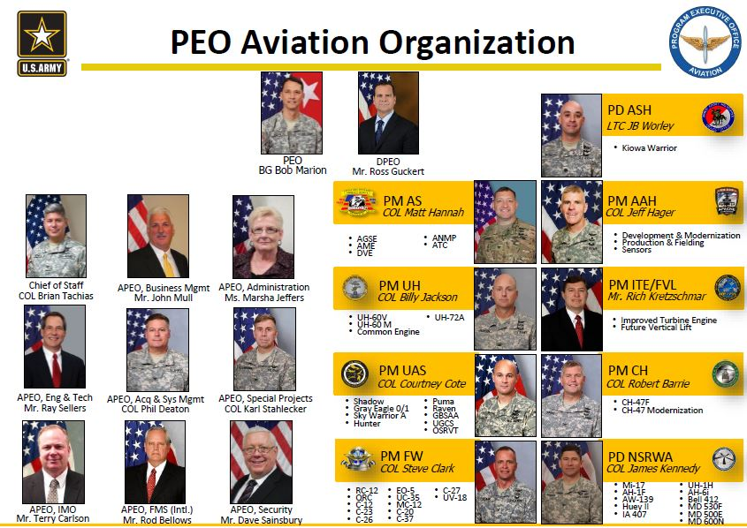
PEO-Aviation Org Chart

Slide 6
PEO-Aviation Programs

Slide 7
PEO Missiles & Space
General Manager
Dr. Steve Messervy
Chief of Staff
Barry Pike
APEO Bus Mgt
Beverly Fuller
APEO IM / IA
Natalie De Luca
MDA LNO
Brent Pope
APEO SBP
Frank De Luca
APEO International
Leigh Moore
APEO Logistics
Amy Barnett
APEO Operations
Robin Campbell
IAMD
Mr. Thomas
PFRMS
COL Rice
NLOS-LS COL Dever
CCWS
LTC(P) Steves
CMDS COL Mullin
Lower Tier
Mr. Edwards
JAMS
COL Cantor
IBCS
HIMARS
GMLRS
ATACMS
PAM
CLU
Javelin
TOW
ITAS
IBAS
JLENS
SLAMRAAM
Sentinel
Stinger / Avenger
DEA
PATRIOT
PAC-3 / MEADS CAP
PAC-3 MSE
JTAGS
JCM / JAGM
HELLFIRE
Hydra
APKWSTM
Viper Strike

Slide 8
AMRDEC Structure

Slide 9
Current Senior Leaders
General Officers Stationed on
Redstone Arsenal (Pre BRAC): 4
U.S. Army Aviation & Missile Command
Major General Commanding General
PEO Aviation
Major General Deputy PEO
PEO Missile and Space
Major General Program Executive
Office
Missile Defense Agency (MDA)
Major General (AF) Deputy for Test,
Integration & Fielding
BRAC Realignments to Redstone: 7
U.S. Army Materiel Command (AMC)
General Commanding General
Lieutenant General Deputy Commander
Major General Chief of Staff
Major General DCS Operations
U.S. Army Security Assistance Cmd (USASAC)
Major General Commanding General
U.S. Army Space & Missile Defense Cmd (SMDC)
*Lieutenant General Commanding General
Missile Defense Agency (MDA)
*Brigadier General (AF) Program Director GMD
Senior Executive Service (SES)
36 DoD SES Currently On Board
55 NASA SES Currently On Board
+ 28 DoD SES – BRAC Realignments
119 Total
*General Officers already
realigned

Slide 10
Contract Vehicles
AMCOM EXPRESS
Vehicle for doing business with AMCOM
Must join during an open season
Best described as a hunting license
SETAC
Contract vehicle for SMDC
Three Primes
Can join at any time
MiDAESS
Provides contractor support to MDA
Organizational Conflict of Interest is an issue
MDA is a difficult organization to deal with

Slide 11
Huntsville Defense Industry
Over 250 companies in Cummins Research Park
All of the Top Ten defense companies are represented
Northern Alabama has a State Center of Excellence for Robotics
Two large universities in town have research institutes
Notes:
Northrop-Grumman will complete their fourth office building in the next two years
The University of Alabama – Huntsville Research Institute has a person on Redstone for business development

Slide 12
Why a Local Representative is Needed
Agencies on post prefer to work with local companies
They want someone available for small meetings/briefings
Like a responsive local face for their engineers to interact with
Much business is developed by word of mouth
Employing a local representative brings new allies
1 Congressman and 2 Senators
Facilitate establishing relationships with quality local companies
Economical
The cost of one business trip will pay a consultant 2 days (16 hours) and gives a manager his time back
Cost sharing of common BD activities such as conferences
There is an undisputed advantage in face-to-face marketing
Capability to go on-post at will
Sparkman Center
Software Engineering Directorate
NASA buildings
They do not have to return your phone call – but they cannot leave if you are standing in the door

Slide 13
Experience
William “Buck” Clemons
Former AH-64 Pilot and Tactical Operations Officer
Electronic Warfare Officer
Joint Mission Planning (Tactical Information Technology)
Former Nat’l Board Member – Association of Old Crows
Active board member or chapter member in many Huntsville Defense related organizations
6 years experience in the Huntsville area
Proven capability to capture business in the Huntsville and Redstone Arsenal areas
Army Aviation (including UAV’s)
Electronic Warfare
Extensive contacts built over 25 years
Familiar with the details of the contract vehicles used
Systems analysis experience in CONOPS, Requirements, and Architectures helps you develop a product that can be used by the military

Slide 14
Contacts
Personally know the business development managers of several businesses
Good relations with both Universities
Personal relationships established with many Government offices
PM-Apache
PM-UAS office
PM-ASE office
PM-UH-60 office
PM-Non-Standard Rotary Wing Aircraft
Space and Missile Defense Command
Software Engineering Directorate
Aviation and Missile Research Development and Engineering Command (AMRDEC)
Briefed many of the SES’ at AMRDEC
Familiar with local Congressional and Senate staffers

Slide 15
Business Development Process
We thoroughly assess your companies capabilities and competencies to find relevant abilities
We will work with your current customer on post to develop business with the Government customer in the cubicle across from them
Join the AMCOM EXPRESS BPA or other contract vehicle
Provide capability briefings to relevant offices
Using the client companies name and e-mail address
Attend local conferences and meetings
Get in front of new business
Provide personal liaison to existing customers
Arrange meetings for the company’s leadership
We can assist with local advertising if desired
Work with the company to develop and refine their product
Working with the PM and his engineers we help develop future requirements
Working with the companies engineers we help refine or modify the product to meet user requirements and desires
We specialize in taking a companies technology and turning it into a weapon system that performs a military mission and fills a capability gap

Slide 16
Formal Process
Awareness
Discover
Qualify
Inform
Diagnose
Design
Differentiate
Propose
Close
Deliver
Clausewitz Involvement
Client Involvement
16
We use a process to develop business rather than happening across opportunities

Slide 17
Support to Marketing Efforts
Message clarification and focus
Can look like a regular employee
Business cards
Email address
Visibility in local target markets
Identify and qualify opportunities before bringing them to the company
Follow-up coordination and liaison as a company rep as needed
Attendance at conferences and local business functions
Identification of business opportunities
Assist in developing marketing message

Slide 18
Advantages
We provide advance knowledge of opportunities before they are officially announced
Most of the details are worked out before the proposal is written
Our direct contact with the Government customer provides us insight into what they say and put on their slides
Trust is important – PMs want their project on time and on budget, having someone to blame afterwards does not help
We know the quirks and personalities of the individuals involved
We know the unwritten rules
We communicate in a language the customer understands

Slide 19
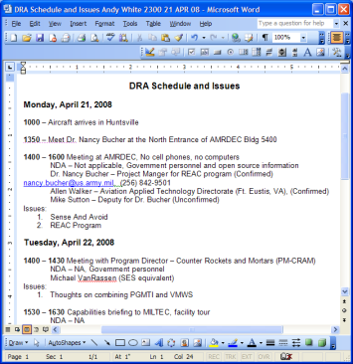
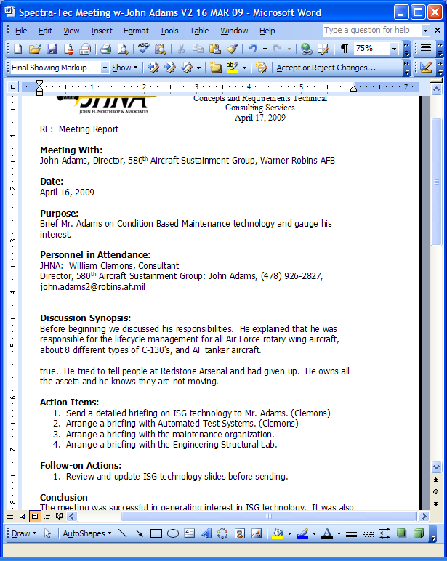
Awareness
Detailed meeting reports
Weekly e-mail reports if desired
Monthly written reports
Written schedule when visiting Huntsville
Detailed invoices
Track daily activities on Twitter
www.linkedin.com/in/buckclemons

Slide 20
Conclusion
Redstone Arsenal has a thriving defense industry that is expanding
A local consultant is affordable and provides for a better relationship with the customer
We can provide a recognized and trusted face to interact with your customer
Thanks for your time
Questions?
Next steps

